Slide 1
Kongfu Panda Security
Guohu Xu / Peng Cheng / Run Huang / Xiaofei Yu / Wenhao He
Chengdu Site

Slide 2
Team introduction
Guohu Xu
Peng Cheng
Run Huang
Xiaofei Yu
Wenhao He

Slide 3


Purpose of our project
To prevent intruders

Slide 4
Techs we use …
Face Recognition
Helix Device Cloud
UVC(USB Video Class) Camera
Web App
Human Detection Sensor

Slide 5


Device structure
System HW structure
Intel x64 board
UVC camera
TI 572x SoC
GPIO LED
GPIO Human detection sensor
HDC
Unix server
UART
NET

Slide 6
System SW structure
WindRiver Linux
UVC cam Device API
VxWorks
GPIO ISR for human detection
Helix Device Cloud
UART R/W
Face recognition
HDC client API
pySerial on UART port
GPIO LED control
Trigger for sending end user alert email when intruders are found
Thing definition
Unix server
Web app (show contents on HDC database)
Web socket
Controlled by Python script

Slide 7
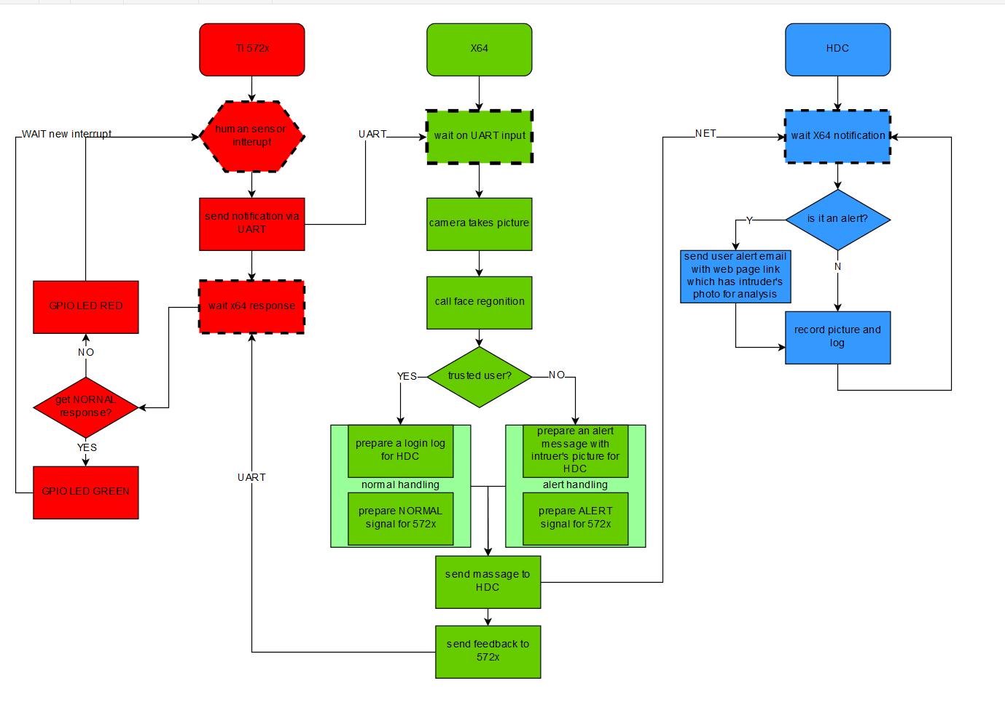
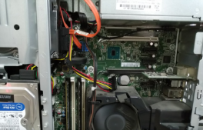
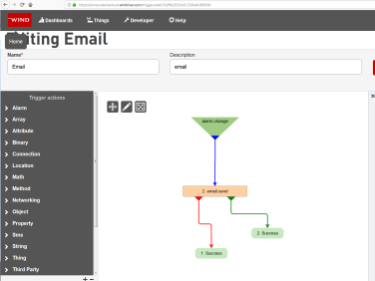

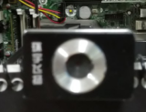
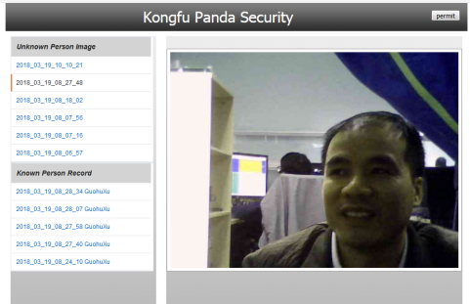
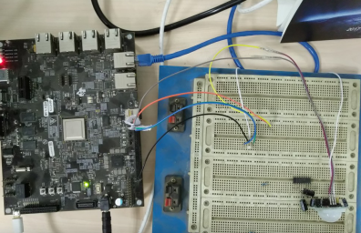

Slide 8

™
8
© 2017 WIND RIVER. ALL RIGHTS RESERVED.

